Slide 1


SAP CPI – Generic Error Handler
A W Mir Ahmed Moosa
174479
BASF Team

Slide 2

Table of Contents
Overview
Technical Details
Generic Error Handler Template
Mail Template

Slide 3
Overview
SAP CPI Error Handler flow to capture the errors of failed messages and report via email.
Scalable and can be enhanced to integrate with monitoring dashboards or any other reporting/ticketing applications.
Error details logged in a canonical structure and used for reporting purpose.
Consolidated reporting for message with multiple records with requirement to split and send each record to target as individual message.
Additional payload capture option available, to be sent as a compressed attachment over mail if required.
Flow parameters are externalized and can be configured based on the specific requirements.

Slide 4
Technical Details
Standard apache camel header and properties used for capturing error details.
Modular implementation design for feature reuse.
Consolidated reporting for message with multiple records achieved using Data Store.
Payload compression is achieved using standard ZIP Compress feature.
Application ID is used as a business identifier for message.
XSLT mapping used to form Email content

Slide 5
Generic Error Capture Structure
<Canonical>
<Record>
<iFlow>${camelContext.getName}</iFlow>
<iFlowStatus>${camelContext.getStatus}</iFlowStatus>
<MessageID>${property.SAP_MessageProcessingLogID}</MessageID>
<CorelationID>${header.SAP_MplCorrelationId}</CorelationID>
<BusinessIdentifyier>${header.SAP_ApplicationID}</BusinessIdentifyier>
<MessageStatus>FAILED</MessageStatus>
<FailedModelStep>${property.SAP_ErrorModelStepID}</FailedModelStep>
<TimeStamp>${property.CamelCreatedTimestamp}</TimeStamp>
<ErrorMessage>${exception.message}</ErrorMessage>
</Record>
</Canonical>

Slide 6
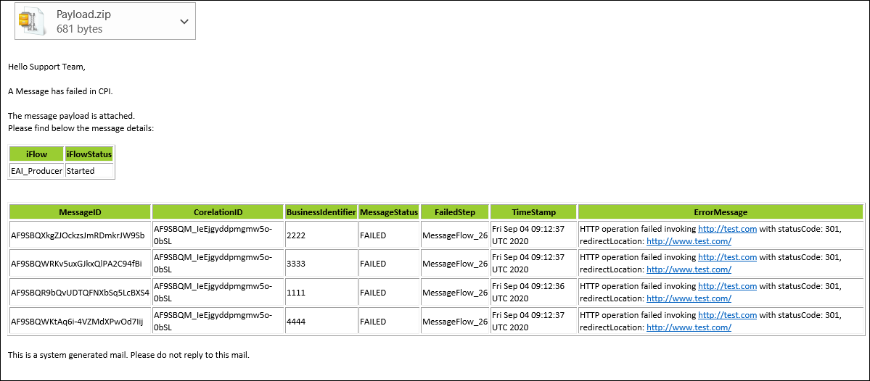
Mail Content
Mail content is structured using XSLT mapping
Values retrieved from generic structure formed while the error was captured

Slide 7


Thank You

